Slide 1
Reinforcement Learning-Based Energy Management of Smart Home with Rooftop Solar Photovoltaic System, Energy Storage System, and Home Appliances
Taeseop Park, Bumsuk Lee, Haejoong Lee
Sogang University, EE
2021.06.10

Slide 2
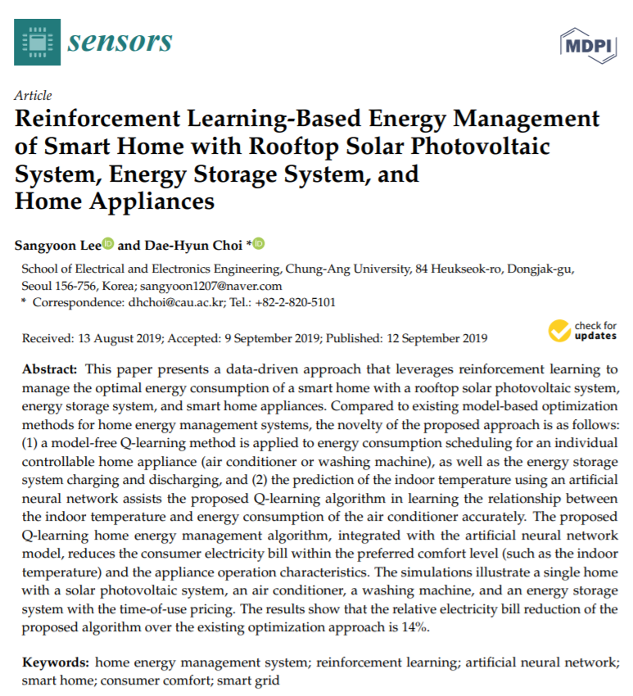
Reinforcement Learning-Based Energy Management of Smart Home with Rooftop Solar Photovoltaic System, Energy Storage System, and Home Appliances
Contents
Background
Introduction
Related Research
System Model for HEMS
Formulation of RL- and ANN-Based Home Energy Management
Numerical Examples
Discussion/Conclusion
Code implementation

Slide 3
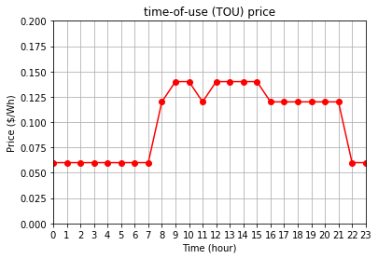
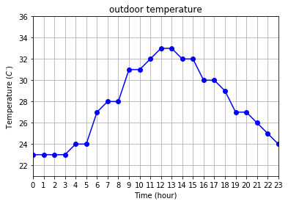
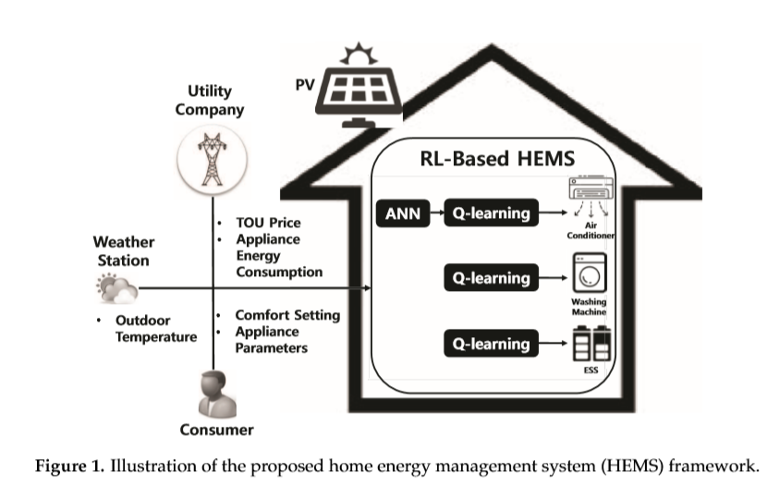
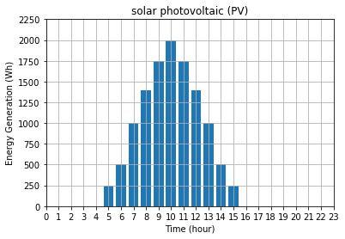
Reinforcement Learning-Based Energy Management of Smart Home with Rooftop Solar Photovoltaic System, Energy Storage System, and Home Appliances
Background
TOU price : time-of-use price (Utility Company)
Appliance Energy Consumption
Outdoor Temperature (Weather Station)
PV systems (solar photovoltaic)
Comfort setting
Appliance Parameters

Slide 4
Introduction
Compared to the existing model-based HEMS optimization approaches, we propose a HEMS algorithm using a model-free reinforcement learning (RL).
The Q-learning method is applied to the energy consumption scheduling of different home appliances (air conditioner, washing machine, and ESS), whereby the agent of each appliance determines the optimal policy independently to reduce its own electric cost within the consumer comfort level and the appliance operation characteristics.
An ANN model to learn the relationship between the indoor temperature and energy consumption of the air conditioner more accurately, which is integrated into the Q-learning module to achieve improved performance of the air conditioner agent.
Simulation showed two results.
1. Using reinforcement learning and
ANN prediction techniques, power
consumption and user
dissatisfaction were reduced.
2. It can save more energy than the
existing mixed-integer linear
programming algorithm.

Slide 5
Related Research
model-based HEMS optimization
the scheduling of different types of home appliances along with electric vehicles using linear programming (LP)
load scheduling considering the consumer comfort level using mixed integer nonlinear programming (MINLP)
convex programming based on relaxed MINLP using an L1 regularization technique
load scheduling for a single consumer or multiple consumers using MILP
LP-based joint optimization of energy supplies and electric loads through three-stage scheduling (prediction, supply control, and demand control)
the natural aggregation algorithm (NAA)-based HEMS method consisting of forecasting, day-ahead scheduling, and actual operation
robust optimization for the scheduling of home appliances to resolve the uncertainty of consumer behavior the outdoor temperature and consumer comfort levels and distributed HEMS architectures consisting of a local and global HEMS.
using real-time pricing, a HEMS optimization method that considers the operational dependency of various types of home appliances and consumer life style requirements was proposed in
model-free reinforcement learning (RL)

Slide 6
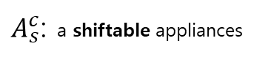
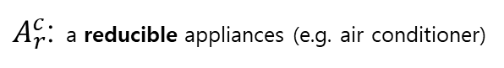
System Model for HEMS
Preliminary
$A^{c}$ : A controllable appliance is an appliance of which the operation is scheduled and controlled by the HEMS.
$A_{r}^{c}$: a reducible appliances (e.g. air conditioner)
$A_{s}^{c}$: a shiftable appliances
$A_{s}^{c,NI}$: a non-interruptible load (e.g. : washing machine)
$A_{s}^{c,I}$: an interruptible load (e.g. : ESS)
$A^{uc}$ : An uncontrollable appliance cannot be scheduled and operated by the HEMS. (e.g. : TV, PC or lighting)
Therefore, $A^{uc}$ maintains the ﬁxed energy consumption scheduling.

Slide 7
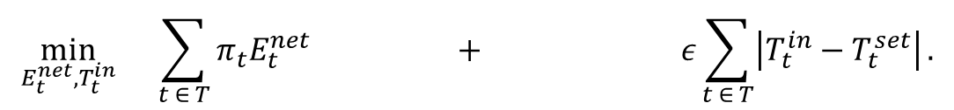
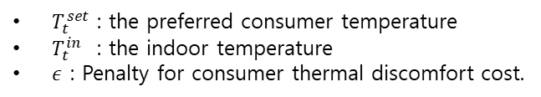
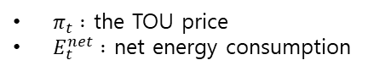
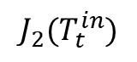
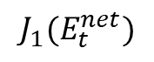
System Model for HEMS
Conventional HEMS Optimization Formulation
Object Function
$$\min_{E_{t}^{net},T_{t}^{in}}{ \sum_{t ∈ T}{π_{t}E_{t}^{net}} + ε\sum_{t ∈ T}{\left|T_{t}^{in}−T_{t}^{set}\right|}.}$$
$$J_{1}(E_{t}^{net})$$
$$J_{2}(T_{t}^{in})$$
Total electricity cost
Total penalty
(consumer discomfort cost)
$π_{t} :$ the TOU price
$E_{t}^{net} :$ net energy consumption
$T_{t}^{set}$ : the preferred consumer temperature
$T_{t}^{in}$ : the indoor temperature
$ε$ : Penalty for consumer thermal discomfort cost.

Slide 8
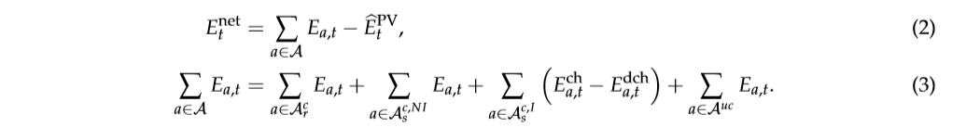
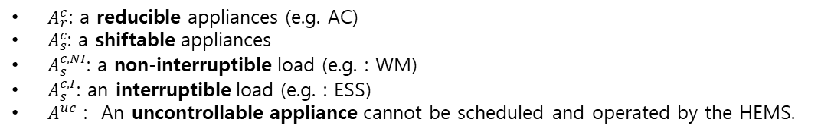
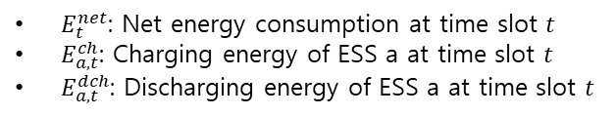
System Model for HEMS
Conventional HEMS Optimization Formulation
Constraint 1 (Net Power Consumption)
the predicted PV generation output
$A_{r}^{c}\text{: }\text{a} \text{reducible} \text{appliances}\text{ (}\text{e}\text{.}\text{g}\text{. }\text{AC}\text{)}$
$A_{s}^{c}$: a shiftable appliances
$A_{s}^{c,NI}$: a non-interruptible load (e.g. : WM)
$A_{s}^{c,I}$: an interruptible load (e.g. : ESS)
$A^{uc}$ : An uncontrollable appliance cannot be scheduled and operated by the HEMS.
$E_{t}^{net}$: Net energy consumption at time slot $t$
$E_{a, t}^{ch}$: Charging energy of ESS a at time slot $t$
$E_{a, t}^{dch}$: Discharging energy of ESS a at time slot $t$

Slide 9
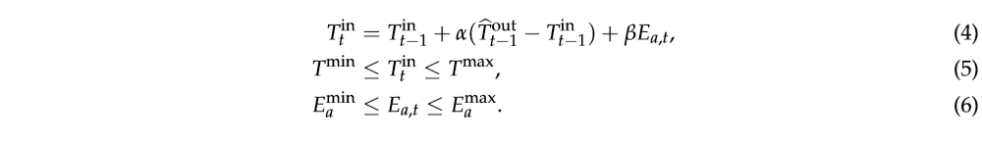
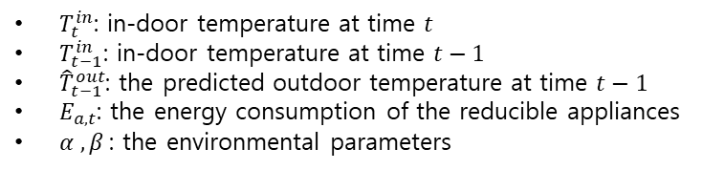
System Model for HEMS
Conventional HEMS Optimization Formulation
Constraint 2 (Operating Characteristics for Controllable Appliances)
e.g. air conditioner
Constraint for the temperature dynamics of the reducible appliance
Consumer preferred indoor temperatures range
Capacity range
$T_{t}^{in}$: in-door temperature at time $t$
$T_{t−1}^{in}$: in-door temperature at time $t−1$
${\hat{T}}_{t−1}^{out}$: the predicted outdoor temperature at time $t−1$
$E_{a,t}$: the energy consumption of the reducible appliances
$α , β$: the environmental parameters

Slide 10
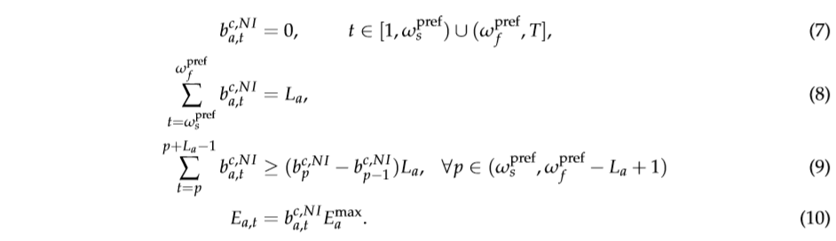
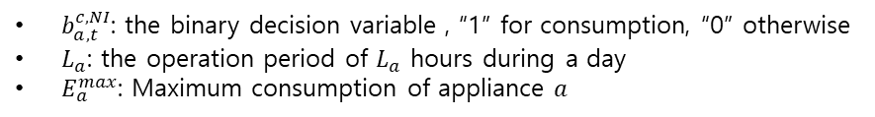
System Model for HEMS
Conventional HEMS Optimization Formulation
Constraint 3 (the desired operation of shiftable appliances with a non-interruptible load)
e.g. washing machine
$b_{a,t}^{c, NI}$: the binary decision variable , “1” for consumption, “0” otherwise
$L_{a}$: the operation period of $L_{a}$ hours during a day
$E_{a}^{max}$: Maximum consumption of appliance $a$

Slide 11
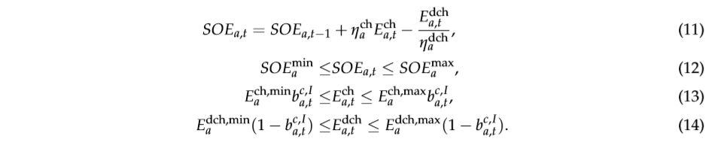
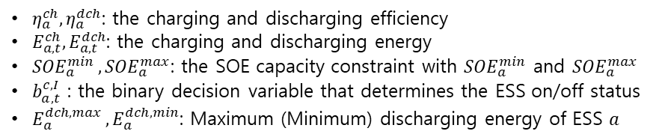
System Model for HEMS
Conventional HEMS Optimization Formulation
Constraint 4 (the operational dynamics of the state of energy (SOE) for the ESS)
e.g. ESS
$η_{a}^{ch},η_{a}^{dch}$: the charging and discharging efficiency
$E_{a,t}^{ch},E_{a,t}^{dch}$: the charging and discharging energy
${SOE}_{a}^{min },{SOE}_{a}^{max}$: the SOE capacity constraint with ${SOE}_{a}^{min}$ and ${SOE}_{a}^{max}$
$b_{a,t}^{c, I}$ : the binary decision variable that determines the ESS on/off status
$E_{a}^{dch,max },E_{a}^{dch,min}$: Maximum (Minimum) discharging energy of ESS $a$
“1” for charging, “0” otherwise

Slide 12
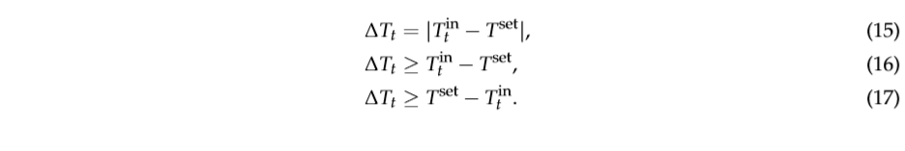
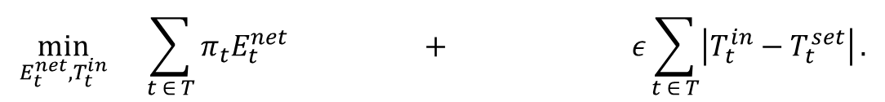
System Model for HEMS
Conventional HEMS Optimization Formulation
MINLP -> MILP by means of the linearization of the nonlinear o.f.
Non-linear
$$\min_{E_{t}^{net},T_{t}^{in}}{ \sum_{t ∈ T}{π_{t}E_{t}^{net}} + ε\sum_{t ∈ T}{\left|T_{t}^{in}−T_{t}^{set}\right|}.}$$
Linear
MINLP (mixed-integer non-linear programming)
MILP (mixed-integer linear programming)

Slide 13
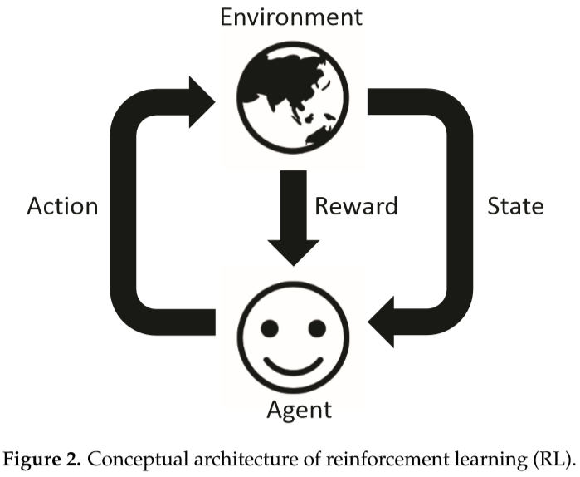
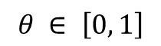
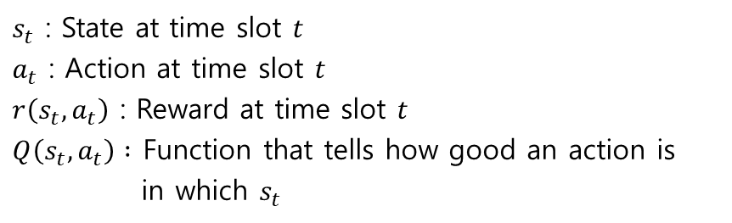
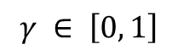
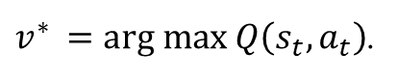
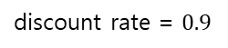
Formulation of RL- and ANN-Based Home Energy Management
Home Energy Management via Q-Learning
$s_{t}$ : State at time slot $t$
$a_{t}$ : Action at time slot $t$
$r\left(s_{t},a_{t}\right)$ : Reward at time slot $t$
$Q\left(s_{t},a_{t}\right) :$ Function that tells how good an action is
in which $s_{t}$
Bellman equation
$$Q_{v^{∗}}^{∗}\left(s_{t},a_{t}\right)=r\left(s_{t},a_{t}\right)+ γ\max{Q\left(s_{t+1},a_{t+1}\right).}$$
$$γ ∈ \left[0, 1\right]$$
discount rate = $0.9$
$Q\left(s_{t},a_{t}\right)$ $←\left(1−θ\right)Q\left(s_{t},a_{t}\right)+θ\left[r\left(s_{t},a_{t}\right)+ γ\max{Q\left(s_{t+1},a_{t+1}\right)}\right]$.
$$θ ∈ \left[0, 1\right]$$
update
learning rate = 0.1
$v^{∗ }=arg max Q\left(s_{t},a_{t}\right)$.

Slide 14
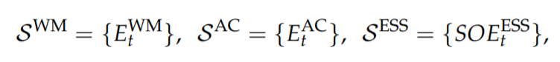
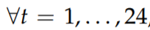
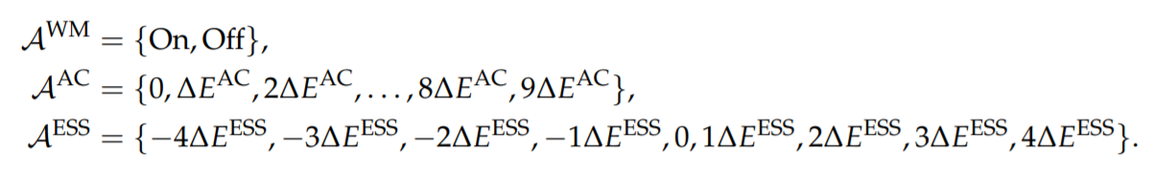
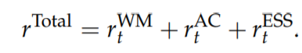
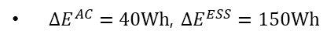
Formulation of RL- and ANN-Based Home Energy Management
Home Energy Management via Q-Learning
State Space
set
Action
Reward
$∆E^{AC}=40Wh$, $∆E^{ESS}=150Wh$

Slide 15
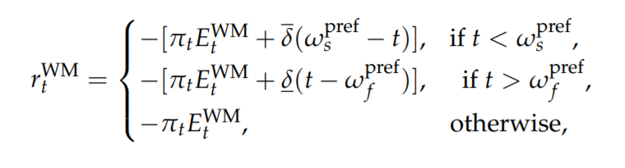
Formulation of RL- and ANN-Based Home Energy Management
Home Energy Management via Q-Learning
(i)
the reward function for the WM agent is expressed as
the electric cost and consumer undesired operation of the WM
Case 1
Case 2
Case 3
Case 1
Case 2
Case 3
start
end
start
end
start
end
0
1
2
3
4
5
6
7
8
9
10
11
12
13
14
15
16
17
18
19
20
21
22
23
$w_{s}^{pref}$, $w_{f}^{pref}$ : the consumer preferred starting and finishing times of the WM
$\overline{δ}, \underline{δ}$: the penalties for early and late operation, respectively, compared to the consumer preferred operation interval

Slide 16
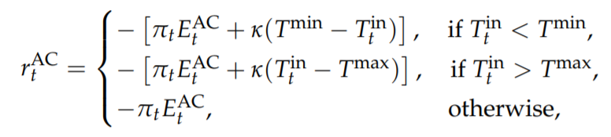
Formulation of RL- and ANN-Based Home Energy Management
Home Energy Management via Q-Learning
(ii)
the reward function for the AC agent is expressed as
the electric cost and consumer thermal discomfort of the AC
Prediction of Indoor Temperature via ANN
$T_{t}^{in}$ : Prediction of Indoor Temperature via ANN
$T^{min}$, $T^{max}$ : the consumer preferred temperature
$k$: the penalty for the consumer thermal discomfort

Slide 17
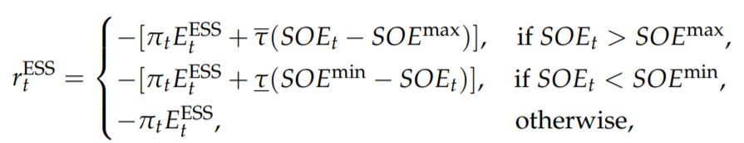
Formulation of RL- and ANN-Based Home Energy Management
Home Energy Management via Q-Learning
(iii)
the reward function for the ESS agent consists of a negative electric cost and negative energy underutilization cost
overcharging
undercharging
${SOE}_{t} :\text{State} \text{of} \text{energy} \text{of} \text{ESS}$
${SOE}^{max}$, ${SOE}^{min}$ : Maximum (Minimum) state of energy of ESS
$\overline{τ}, \underline{τ}$: the penalties for the ESS overcharging and undercharging

Slide 18
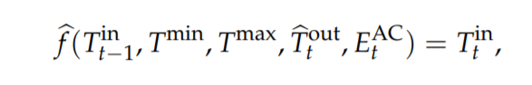
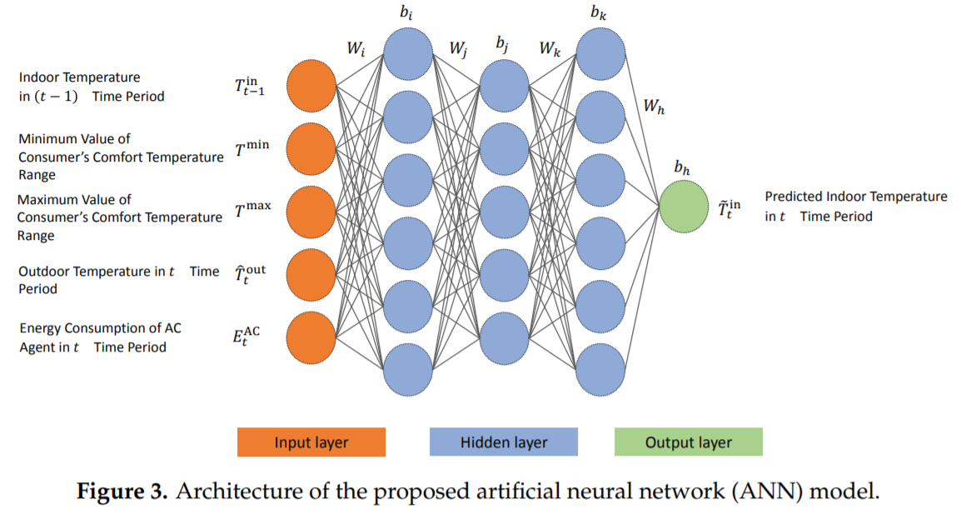
Formulation of RL- and ANN-Based Home Energy Management
Prediction of Indoor Temperature via ANN
Two advantages
- calculate the dissatisfaction cost more precisely
- determine the optimal energy consumption
schedule more efficiently
Optimizer : adam
Learning rate : 0.005
Activation function : ReLU

Slide 19
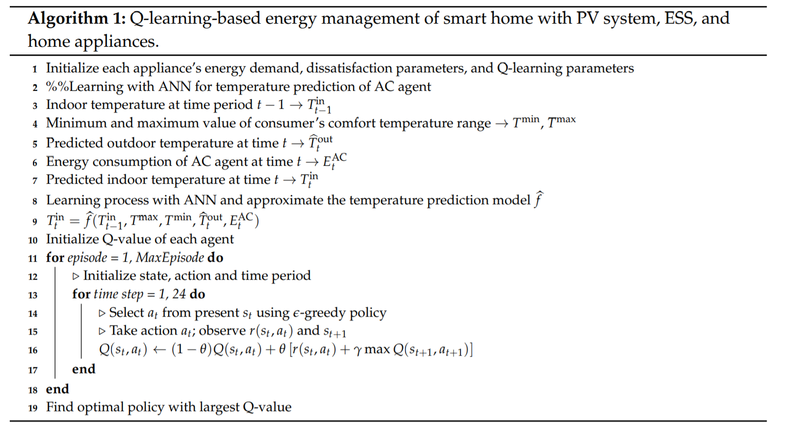
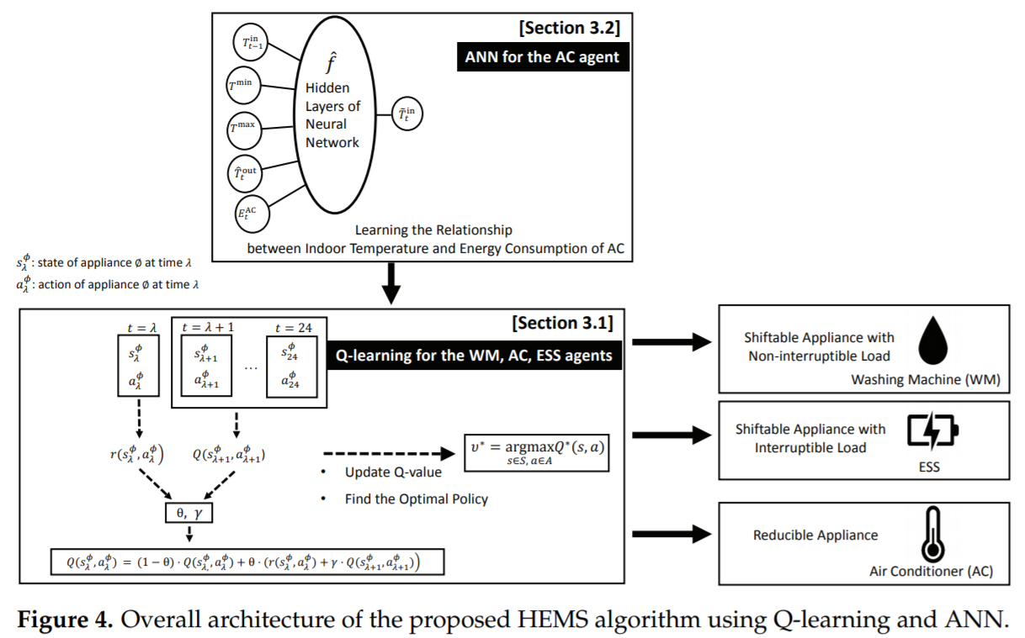
Formulation of RL- and ANN-Based Home Energy Management
Algorithm

Slide 20
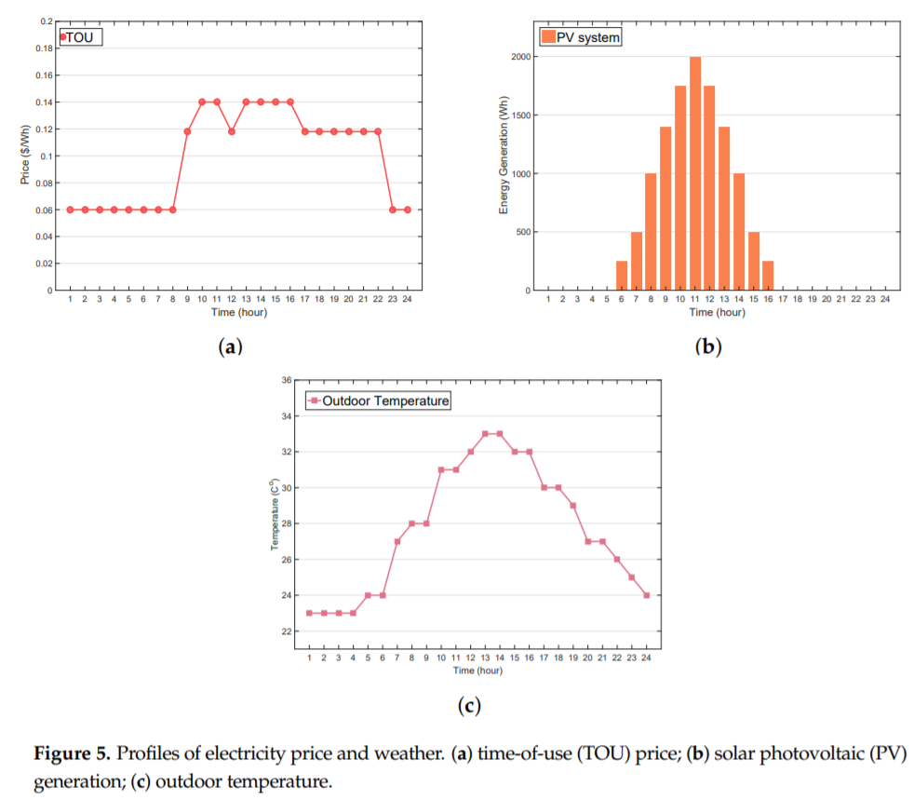
Numerical Examples
Simulation Setup

Slide 21
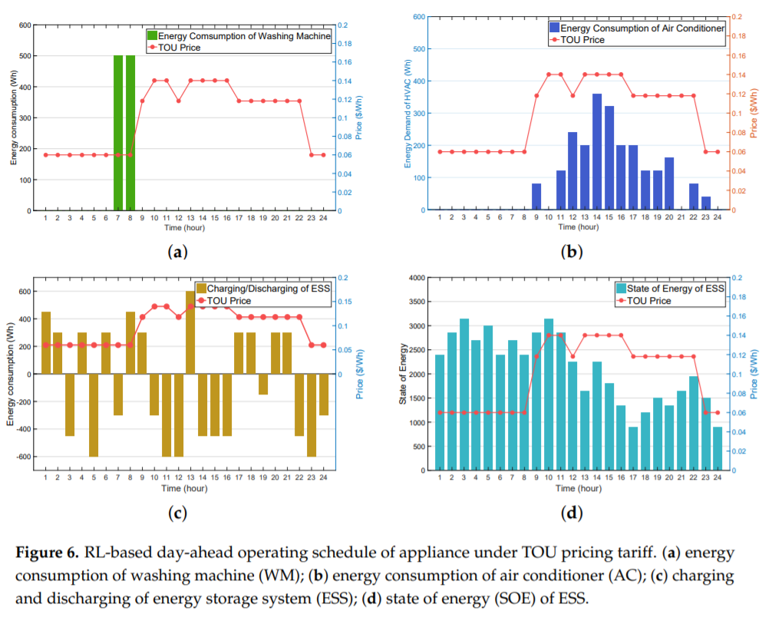
Numerical Examples
Performance of the Proposed RL-Based HEMS Algorithm

Slide 22
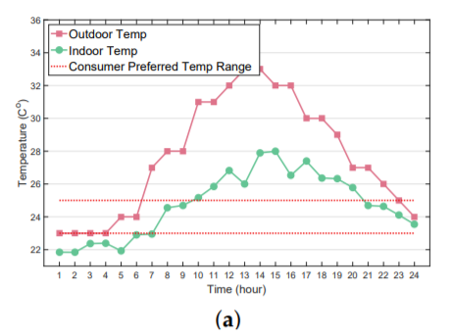
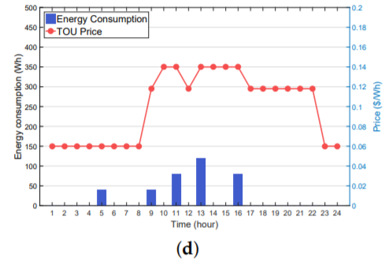
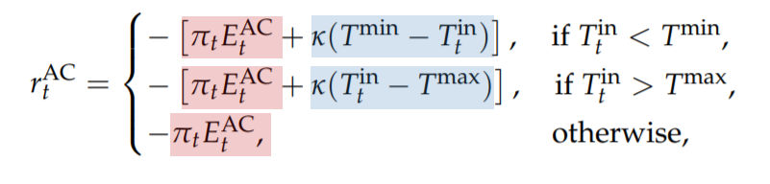
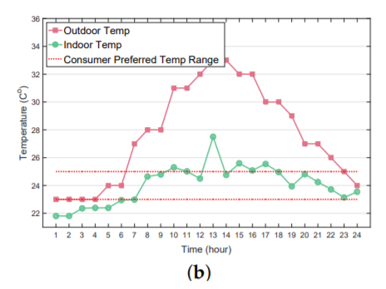
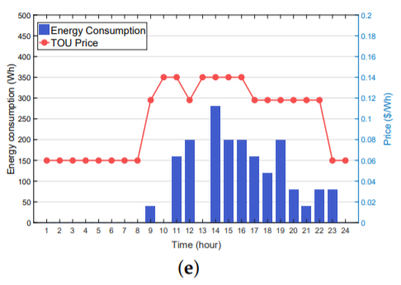
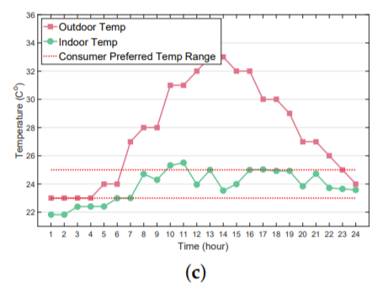
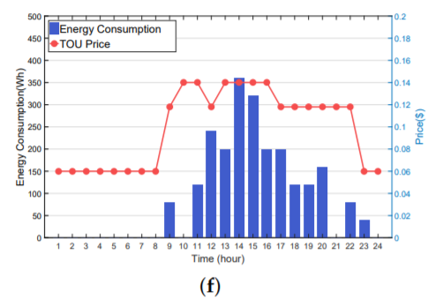






Numerical Examples
Impact of Different Parameters in Reward Function on the Proposed Algorithm
$$k=10$$
$$k=10$$
$$k=50$$
$$k=50$$
$$k=100$$
$$k=100$$

Slide 23



Numerical Examples
Impact of Different Parameters in Reward Function on the Proposed Algorithm

Slide 24

Numerical Examples
Impact of ANN on AC Agent Performance

Slide 25

Numerical Examples
Performance Comparison between MILP- and RL-Based HEMS

Slide 26


Numerical Examples
Performance Comparison between MILP- and RL-Based HEMS

Slide 27

Numerical Examples
Performance Comparison between MILP- and RL-Based HEMS

Slide 28
Discussion / Future work
Discussion
Wholesale and Retail Electricity Markets under Real-Time Pricing (RTP)
Electric Vehicle (EV) Integration
Constraint of the Lifetime for ESS
Since the data used in the simulation is a deterministic value, it is different from reality.
Future work
Develop A multi-agent reinforcement learning algorithm
The practical implementation of the developed algorithm should be tested in large-scale realistic electric power networks.
Plan to integrate advanced neural network models such as recurrent neural networks and long short-term memory in the proposed framework to improve the prediction accuracy of the indoor temperature.

Slide 29





Code implementation
Visualization
“AC_agent” 에 넘기는 reward에 따라 결과가 다름
x
수집된 data 가 없는 관계로
ETP 식으로 대체
O
paper
our code
$$reward={r_{t}^{WM}+ r}_{t}^{AC}+r_{t}^{ESS}$$
$$reward=r_{t}^{AC}$$
ETP : the equivalent thermal parameters (ETP) model Equation

Slide 30



Code implementation
Visualization
$\left[ω_{s}^{pref},ω_{f}^{pref}\right]를 \left[6, 22\right]$ 및 $\left[12, 22\right] 로$ 설정한 결과 TOU에 따라 스케줄이 다름을 확인
최종 “ESS_agent”로 부터 도출된 시간 및 TOU에 따른 ESS 스케줄 시각화

